Slide 1
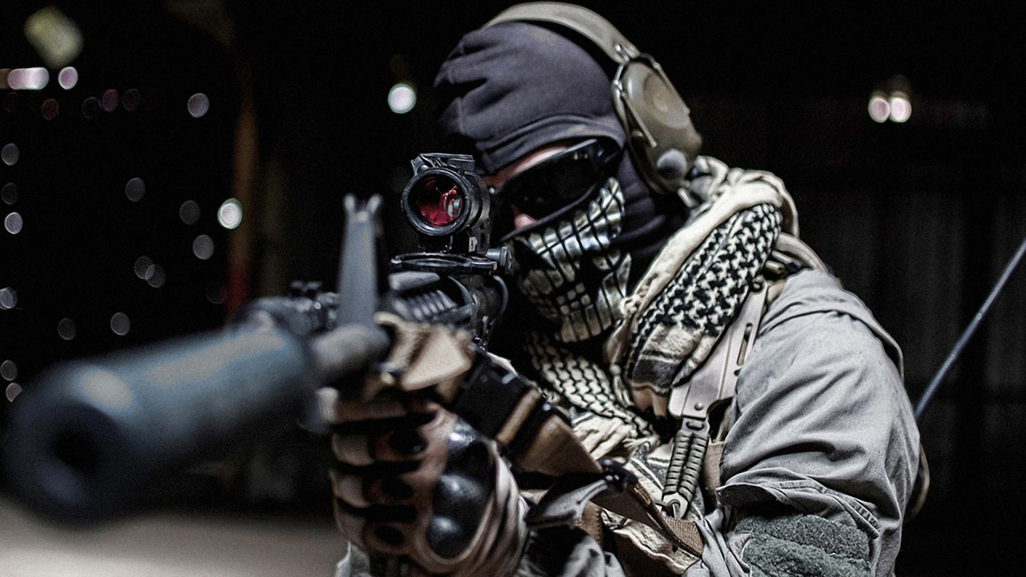
EDA(EXPLORATORY DATA ANALYSIS)
ON GLOBAL TERRORISM DATASET
AUTHOR NAME - Er.Chandra Shekhar Saraswat

Slide 2
INTRODUCTION
Terrorism is a significant threat to global security, and it has become a major concern for governments and international organizations worldwide. In recent years, the world has witnessed an increase in the frequency and intensity of terrorist attacks, which has resulted in the loss of countless lives and caused significant economic damage. To address this problem, it is essential to understand the patterns and trends of terrorism globally. In this presentation, we will take a closer look at global terrorism data and analyze its key features and trends.

Slide 3
SOURCE OF GLOBAL TERRORISM DATASET
The Global Terrorism Database (GTD) is an open-source database of terrorist attacks worldwide, maintained by the National Consortium for the Study of Terrorism and Responses to Terrorism (START) at the University of Maryland. The database contains information on over 200,000 terrorist incidents from 1970 to 2020, making it one of the most comprehensive sources of terrorism data available.
IMPORTANCE OF THIS DATASET
Global terrorism data is important because it helps us understand the nature and extent of the terrorist threat, track the effectiveness of counterterrorism efforts, identify emerging threats, and evaluate the impact of terrorism. This information is critical for developing effective policies and strategies to combat the threat of terrorism and ensure the safety and security of people worldwide.

Slide 4
KEY FEATURES OF DATASET
The GTD provides a wealth of information on terrorist incidents worldwide, including data on the location, time, type, and target of attacks, as well as the number of fatalities and injuries. The database also includes information on the perpetrators and their motives, as well as the weapons and tactics used in each attack. By analyzing this data, we can identify patterns and trends in global terrorism and gain insights into the nature of the threat.
VARIABLES - Variables that were already presented in our dataset
Month: Month in which incident occurred
Incident_Duration: Whether incident extended more than 24 hours or not -> (1="Yes",0="No")
City: City where incident occurred
Country: Country where incident occurred
Region: Region where incident occurred
Latitude: Latitude of city where incident occurred
Longitude: Longitude of city where incident occurred
Success: Whether the attack was successful or not -> (1="Yes",0="No")
Attack_Type: Method of attack used -> (Assassination,Hijacking,Kidnapping,Barricade Incident,Bombing/Explosion,Armed Assault,Unarmed Assault,Facility/Infrastructure Attack,Unknown)
Suicide: Incident was a suicede attack or not -> (1="Yes",0="No")
Target_type: This variable captures the general type of target/victim
Target_SubCat: This variable captures the more specific target category and provides the next level of designation for each target type
Terror_Group: Name of the group that carried out the attack
Terror_Motive: Specific motive for the attack
Weapon_Type: General type of weapon used in the incident
Weapon_Subtype: More specific value for most of the Weapon Types identified
Total_Killed: This variable stores the number of total confirmed fatalities for the incident. The number includes all victims and attackers who died as a direct result of the incident.
Total_Wounded: This variable records the number of confirmed non-fatal injuries to both perpetrators and victims.
Terrorists_Killed: This variable records total confirmed perpetrators fatalities.
Year: Year in which incident occurred.

Slide 5
Variables defined by user and there use.
1 .Gt_data -> preprocessed data in dataframe format.
2 .New_GT_data -> Processed data in dataframe format.
3 .New_GT_data.shape -> To get the Total number of rows and columns in dataset.
4 .Gt_data.rename(columns=) -> To rename columns of dataset to increase user understandability.
5 .New_GT_data.head()- > To get the first 5 rows of dataset.
6 .New_GT_data.info()- > To get info about all columns in dataset.
7 .New_GT_data.describe() - > To get basic stats of columns in dataset.
8 .New_GT_data.nunique() - > To check no of unique values in dataset.
9 .New_GT_data.drop_duplicates(keep=False) -> To drop duplicate values in dataset.
10.New_GT_data['Column Name’].fillna() -> To fill null values with desired statistical measure.
11.New_GT_data['Column Name'].replace()-> To replace value with desired value.

Slide 6
Libraries
PANDAS
MATPLOTLIB
SEABORN
PLOTLY

Slide 7

DATA VISUALISATION

Slide 8
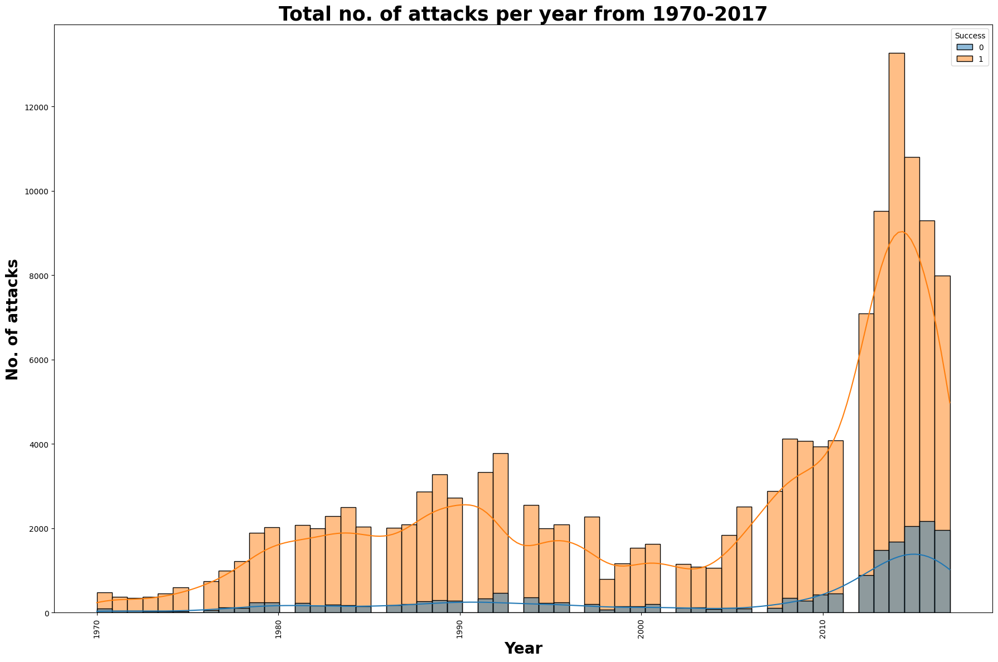
Plot used - Histogram with kde = True
Inference approach - Decadal time line to understand the pattern of terrorism across globe.
Insights :-
-> DECADE 1 (1970-1980) -
1-One major factor was the Cold War, which fueled regional conflicts and proxy wars between the superpowers of the United States and the Soviet Union.
2- During this time period many countries experienced economic instability and social unrest, which also contributed to the rise of terrorism.
3- Another contributing factor was the ease with which terrorist groups could obtain weapons and funding from various sources.
-> DECADE 2 (1980-1990)- The 1980s was a decade marked by several high-profile terrorist attacks, many of which were motivated by political and ideological
reasons.
1-The 1983 Beirut barracks bombings: In October 1983, two truck bombs were detonated by suicide bombers in Beirut, Lebanon, killing 241 U.S. and 58 French
military personnel. The attacks were carried out by the Islamic Jihad Organization, a Shia militant group with ties to Iran.
2- The 1985 Air India Flight 182 bombing: In June 1985, a bomb exploded on Air India Flight 182 en route from Toronto to Delhi, killing all 329 people on board.
The attack was carried out by Sikh separatists seeking an independent homeland in India.
3 - The 1988 Pan Am Flight 103 bombing: In December 1988, a bomb exploded on Pan Am Flight 103 over Lockerbie, Scotland, killing all 243 passengers and 16
crew members on board, as well as 11 people on the ground. The attack was carried out by Libyan agents.
-> DECADE 3 (1990-2000) -After hitting the peak in 1992, terrorism decreased in the subsequent years . Reason can be stated below -
1 - Political changes: The end of the Cold War in the late 1980s and early 1990s led to significant political changes around the world. Many countries, particularly in Eastern Europe,
underwent democratic transitions, which helped to reduce political violence and extremism.
2 - Diplomacy: The use of diplomacy and negotiation helped to resolve several long standing conflicts that had fueled terrorism. For example, the Good Friday Agreement of 1998
ended decades of violence in Northern Ireland.
3- Law enforcement: Increased law enforcement efforts and intelligence gathering played a role in reducing terrorist activity. Governments around the world invested in new
technologies and improved cooperation between agencies to better track and disrupt terrorist groups.
-> DECADE 4 & 5 (2000-2017) -
1 - Regional conflicts: Ongoing conflicts in regions such as the Middle East and North Africa created conditions in which terrorist groups could thrive.
These conflicts provided a fertile ground for recruitment, training, and funding of terrorist groups.
2 - Spread of extremist ideologies: The rise of the internet and social media allowed extremist groups to spread their ideologies and recruit members on a global scale.
Social media platforms became a tool for radicalization and propaganda, helping to spread extremist messages to a wide audience.
3- Weak governance: In many parts of the world, weak governance and political instability created conditions in which terrorist groups could operate
with relative impunity.

Slide 9
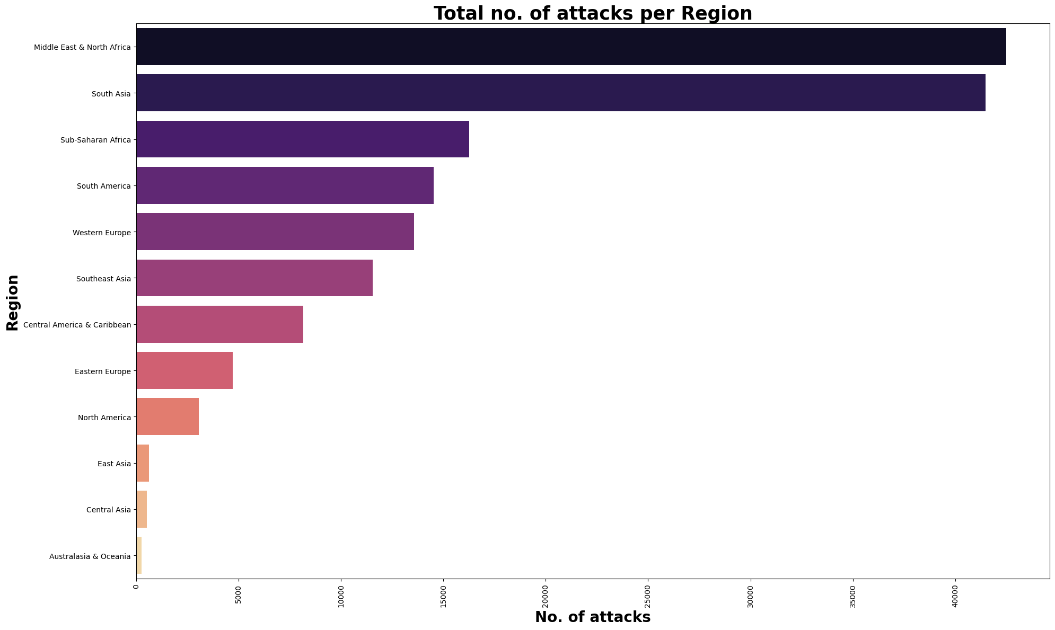
Middle East & North Africa region and South Asia have the highest and second highest terrorism rate respectively.
Many countries in both the regions have experienced political instability and conflict in recent years, which has created a power vacuum that terrorist groups have been able to exploit.
The Middle East & North Africa region is also characterized by deep-seated sectarian tensions, particularly between Sunni and Shia Muslims, which have fueled conflict and violence.
Both regions have significant economic disparities, with a small elite controlling much of the wealth while many ordinary people struggle with poverty and unemployment. This can create a sense of desperation and hopelessness, which terrorist groups can exploit.
The involvement of foreign powers in the regions, both historically and in recent years, has often exacerbated tensions and conflicts, providing an environment in which extremist ideologies can flourish.
There are also specific factors that contribute to the radicalization of individuals, including exposure to extremist propaganda, social and economic marginalization, and a sense of alienation from mainstream society.
East Asia, Central Asia, and Australasia and Oceania have the lowest number of terrorism attacks. Possible reasons might be:
Many countries in these regions have stable political systems and effective governments that are able to provide security and maintain law and order. This can help to prevent the emergence of terrorist groups or limit their ability to operate.
While there are certainly religious communities in these regions, there is generally less religious extremism than in other parts of the world.
Some countries in these regions are geographically isolated, which can make it more difficult for terrorist groups to enter or operate in these areas.

Slide 10
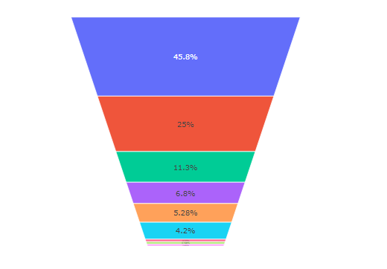
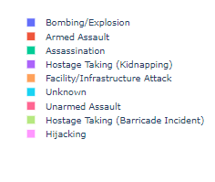
TYPE OF ATTACK
Bombing or explosion is the most common attack type because it can cause widespread damage and casualties, and it can be carried out with relative ease and anonymity.
Explosive devices can be easily concealed and transported, making them an attractive choice for individuals or groups seeking to cause harm. Additionally, explosives can be detonated from a distance, allowing the attacker to avoid detection and escape.
Furthermore, bombing attacks can create a significant psychological impact on the targeted population, spreading fear and terror. This effect is amplified when the attack is carried out in a public place or against a symbolic target, such as a government building or a religious site.
Hijacking is one of the least common attack method. Since the 9/11 attacks, security measures in airports have been significantly improved. There are now strict regulations and procedures in place to prevent unauthorized access to planes, which has made it much more difficult for hijackers to carry out their plans. Government cooperation and sharing of intelligence along with the use of technology such as biometric identification, surveillance cameras, and explosive detection systems has made it easier to identify potential hijackers and prevent them from boarding planes.

Slide 11
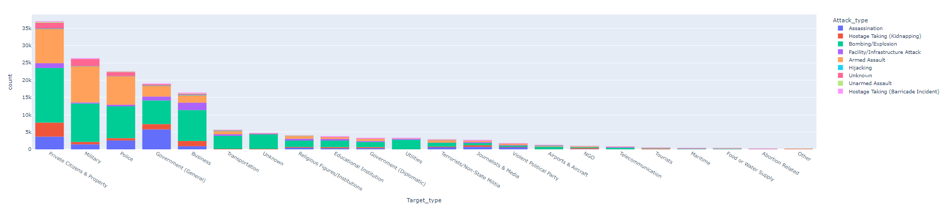
Which target categories are vulnerable.
Private Citizens and Property-From the above figure we can see that private citizens and property are the most targeted by the terrorists because targeting civilians and non-combatants can create fear and panic among the population. Private citizens are often viewed as softer targets and can be targeted as a means of disrupting the economy and social order. Attacks on businesses and infrastructure can have a ripple effect, leading to economic disruption and social unrest.Bombing or explosion is a common attack type used by terrorists for attacking citizens because it is a highly effective and devastating form of violence that can cause mass casualties and damage to infrastructure. Terrorists use bombs and explosives to create fear and panic among the population, to draw attention to their cause, and to inflict maximum damage on their targets. Bombings can be carried out with a high degree of anonymity and can be relatively easy to plan and execute, making them an attractive option for terrorist groups with limited resources and manpower.
Military-Military targets often have a high symbolic value, representing the power and authority of the state, so, it doesn't come as a surprise that they are the second most targeted place by terrorists. Military targets may have strategic value for terrorist groups, such as disrupting the government's ability to maintain law and order, or interfering with military operations that are seen as threatening to the terrorists' objectives.
Police-Police officers represent law and order, the government's authority, and the state's power. Attacking police officers can send a message that the government is unable to protect its citizens, and that terrorists can strike anywhere, anytime. Police officers are often the first responders to an incident, and they play a critical role in maintaining public safety. By targeting police officers, terrorists can create chaos and disrupt law enforcement efforts, giving them an advantage.Police are often attacked in a similar way as military.
Government-Government officials often have access to sensitive information and decision-making power that could affect the terrorists' goals. Terrorists may have political goals that are directly opposed to the policies of the government, and attacking government officials is seen as a way to undermine those policies and weaken the government's ability to govern. By targeting government officials, terrorists aim to intimidate not only the officials themselves but also the broader population, making them fear for their safety and creating a sense of chaos and instability. Bombing, assassination, and armed assault are all effective tactics for achieving this goal.
Business-One of the most common reasons terrorists target businesses is to create economic damage. By attacking businesses, terrorists can disrupt supply chains, shut down production, and cause financial losses. This can weaken the economy and make it harder for the government to function. Attacks on businesses can be particularly effective at creating a sense of vulnerability and insecurity, as people may see these attacks as a direct threat to their livelihoods. Businesses may also be targeted because of their symbolic significance. For example, the World Trade Center in New York was targeted by terrorists on 9/11 because of its importance as a global financial center.

Slide 12
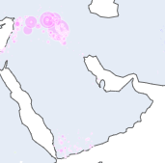
GROUPS INVOLVED IN DIFFERENT THEATRES ACROSS GLOBE FROM 1970-2017.
THEATRE - MIDDLE EAST
Israel
TERROR GROUP - Palestinian Extremists MOTIVE - "Liberation of Palestine" and recognition of a Palestinian state.
TERROR GROUP - HAMAS MOTIVE - Hamas' declared objectives are to liberate Palestine from Israeli occupation and transform the country into an Islamic state. Which of these two objectives is the primary goal is disputed. The movement's original charter committed it to waging an armed struggle to destroy the state of Israel.
TERROR GROUP - Sheikh Omar Hadid Brigade MOTIVE - The geopolitical ideology of the Sheikh Omar Hadid Brigade can hence be defined as Pan-Islamist.
TERROR GROUP - Palestinian Islamic Jihad (PIJ) MOTIVE - Israelis will accept neither a two state nor a one state solution and that the only choice is to continue the armed struggle until Israel's defeat.
TERROR GROUP - Mujahideen Shura Council in the Environs of Jerusalem MOTIVE - Carried out attacks against civilians in Israel.
TERROR GROUP - Popular Resistance Committees MOTIVE - To defeat Israel.
TERROR GROUP - Al-Aqsa Martyrs' Brigades MOTIVE- To establish palestine state.
TERROR GROUP - Martyr Sami al-Ghul Brigades MOTIVE - To defeat israel and establish palestine state.
TERROR GROUP - Hezbollah MOTIVE - Opposes the government and policies of the State of Israel, but also each and every Jewish civilian who lives in Israel.
TERROR GROUP - Abu Nidal Organization (ANO) MOTIVE - To spread Palestinian nationalism,Anti-Zionism,Secularism.
IRAN
TERROR GROUP - Kurdistan Free Life Party MOTIVE - It has waged an intermittent armed struggle since 2004 against the Iranian regime, seeking self-determination through some degree of autonomy for Kurds in Iran.
TERROR GROUP - Kurdistan Workers' Party (PKK) MOTIVE - The goals of national autonomy and democratic confederalism.
TERROR GROUP - ISLAMIC STATE OF IRAQ AND THE LEVANT(ISIL) MOTIVE - Goal is to solidify and expand its control of territory once ruled by early Muslim caliphs and to govern through implementation of its strict interpretation of sharia.
TERROR GROUP - Jaish ul-Adl MOTIVE - The group maintain ties with Ansar Al-Furqan which is another Iranian Baloch Sunni armed group operating in Iran.
TERROR GROUP - Jundallah (the People's Resistance Movement of Iran) MOTIVE - fighting exclusively for the rights of Sunni Muslims in Iran.
TERROR GROUP - Mojahedin-e-Khalq (MEK) MOTIVE - Espoused the creation of a classless society that would combat world imperialism, international Zionism, colonialism, exploitation, racism, and multinational corporations.
TERROR GROUP - Forqan Group MOTIVE - Promoted a view of Islam that opposes the existence of religious clergy.
TERROR GROUP - Iranian People's Fadaee Guerrillas MOTIVE - Operation against Pahlavi government.
fig-1

Slide 13
GROUPS INVOLVED IN DIFFERENT THEATRES ACROSS GLOBE FROM 1970-2017.
THEATRE - MIDDLE EAST
SAUDI ARABIA
TERROR GROUP - Houthi extremists (Ansar Allah) MOTIVE - The Houthis have portrayed themselves as national resistance, defending all Yemenis from outside aggression and influences, as champions against corruption, chaos, and extremism, and as representative for the interests of marginalized tribal groups and the Zayidi sect.
TERROR GROUP - Islamic State of Iraq and the Levant (ISIL) MOTIVE - To take part in the group’s campaign of violence and help the caliphate grow.
IRAQ
TERROR GROUP - Islamic State of Iraq and the Levant (ISIL) MOTIVE - ISIL’s stated goal is to solidify and expand its control of territory once ruled by early Muslim caliphs and to govern through implementation of its strict interpretation of sharia. The group’s strength and expansionary agenda pose an increasing threat to US regional allies and US facilities and personnel in the Middle East as well as in the West.
TERROR GROUP - White Flags MOTIVE - Kurdish resistance
TERROR GROUP - Asa'ib Ahl al-Haqq MOTIVE - Shia Jihadism,Wilayat al Faqih,Khomeinism,Mohammed Sadiq, al-Sadr thought,Anti-Zionism,Anti-Americanism,Pan-Islamism,Anti-West,Anti-LGBT, Kazem al-Haeri.
TERROR GROUP - Saraya al Salam(Peace Companies) MOTIVE - Anti-Coalition,Anti-Americanism,Anti-Zionism.
TERROR GROUP - Army of the Men of the Naqshbandi Order MOTIVE - To restore the old order under the Ba'athist ideology and forced to send foreign troops outside Iraq.
TERROR GROUP - General Military Council for Iraqi Revolutionaries MOTIVE - Insurgency against the Iraqi government.
TERROR GROUP - Ansar al-Islam MOTIVE - Motive is to establish an Islamic state around the Kurdistan region and to protect Kurdish people.
TERROR GROUP - Al-Qaeda in Iraq (AQI) MOTIVE - Four-stage plan beginning with taking control of Iraq. Step 1: expulsion of US forces from Iraq. Step 2: establishing in Iraq an Islamic authority—a caliphate. Step 3: "the jihad wave" should be extended to "the secular countries neighbouring Iraq". Step 4: "the clash with Israel".
TERROR GROUP - Islamic State of Iraq (ISI) MOTIVE - To establish an Islamic state in Sunni, Arab-majority areas of Iraq.
TERROR GROUP - al-Qaeda's Kurdish Brigades MOTIVE - It is the Kurdish branch of al-Qaeda that has launched several attacks on the Kurdistan Regional Government in northern Iraq.
TERROR GROUP - Peshmerga MOTIVE - Combating the ruling power in the region of what is now Iraqi Kurdistan.
fig-1

Slide 14
GROUPS INVOLVED IN DIFFERENT THEATRES ACROSS GLOBE FROM 1970-2017.
THEATRE - MIDDLE EAST
LEBANON
TERROR GROUP - Hezbollah MOTIVE - The ideology of Hezbollah has been summarized as Shi'i radicalism.
TERROR GROUP - Hay'at Tahrir al-Sham (HTS) MOTIVE - To achieve "Popular Jihad", a bottom-to-top approach in which jihadists would win the hearts and minds of the people, before setting out to establish jihadi governance.
TERROR GROUP- Sunni Resistance Committees in Lebanon (SRCL) MOTIVE - To oppose hezbollah in lebanon.
TERROR GROUP - Islamic State of Iraq and the Levant (ISIL) MOTIVE - Continue to seize land and take over the entire Earth until its
TERROR GROUP - Fatah al-Islam MOTIVE - Primary goals are to institute Islamic law in Palestinian refugee camps and to target Israel.
TERROR GROUP - Kouweikhat group. MOTIVE - Bader Eid, brother of Arab Democratic Party leader Ali Eid, was ambushed by gunmen on the highway linking the Akkar towns of Haysa and Kouweikhat because he was main suspect in mosque bombing in 2013 at Tripoli.
TERROR GROUP - Mawlawi and Mansour Group MOTIVE - To oppose govt regime and express resistance by eliminating military personel.
TERROR GROUP - Al-Nusra Front MOTIVE - To oppose Lebanon government and to achieve there goals listed below
Better integrate his movement within the Syrian revolution and its people.
Coordinate more closely with all Islamic groups on the ground.
Contribute towards the establishment of a Syria-wide sharia judicial court system.
Use strategic areas of the country to build a sustainable Al-Qaeda power base.
Cease any activity linked to attacking the West.
TERROR GROUP - Ahrar al-Sunna Baalbek Brigade( Free Sunnis of Baalbek Brigade) MOTIVE - It retaliated against the Shia Islamist group Hezbollah, after clashes between locals Sunnis in Baalbek and members of Hezbollah.
TERROR GROUP - Abdullah Azzam Brigades MOTIVE - The group said the bombing was retaliation for Iranian support of Hezbollah, which fights on the Syrian government's side in the current Syrian civil war, and warned of further attacks should Iran's government not acquiesce.
TERROR GROUP - Faithful Resistance MOTIVE - Faithful Resistance against Israeli forces in southern Lebanon. Two years earlier, in January 1986, the Faithful Resistance had carried out a Katyusha rocket attack on northern Israel.
TERROR GROUP - Lebanese National Resistance Front(LNRF) MOTIVE - Calling for the Lebanese people to raise up in arms and unite into a "Lebanese National Resistance Front" against the Israeli Occupation.
TERROR GROUP - Palestine Liberation Organization(PLO) MOTIVE - Resisting siege laid down by armed forces Israel .
TERROR GROUP - Lebanese Resistance Group MOTIVE - To fight Lebanese Civil War.
TERROR GROUP - Front for the Liberation of Lebanon from Foreigners (FLLF) MOTIVE - To fight lebanense civil war.
TERROR GROUP - Lebanese Arab Army (LAA) MOTIVE - To fight Lebanese Civil War.
fig-1

Slide 15

GROUPS INVOLVED IN DIFFERENT THEATRES ACROSS GLOBE FROM 1970-2017.
THEATRE - MIDDLE EAST
SYRIA
TERROR GROUP - Islamic State in Iraq and Syria (ISIS) MOTIVE - The group’s goal is to establish an Islamic caliphate in Iraq and Syria and eventually spread its influence globally.
TERROR GROUP - Islamic State in Iraq and Levanant (ISIL) MOTIVE - Establish an Islamic caliphate in Iraq and Syria and to create a global Salafi-Jihadist movement.
TERROR GROUP - Kurdistan Workers' Party (PKK) MOTIVE - Aim to replace the United Nations, capitalism and nation state with the democratic confederalism which is described as a system of popularly elected administrative councils, allowing local communities to exercise autonomous control over their assets while linking to other communities via a network of confederal councils.
TERROR GROUP - Jaysh al-Islam MOTIVE - Jaysh al-Islam has called for the Syrian government to be replaced by a technocratic body that represents the diversity of the Syrian people.In 2016, Jaysh al-Islam's ideology was described as a "mixture" of Salafism, Syrian nationalism, "and at least in the past, a significant dose of Sunni sectarianism".
TERROR GROUP - Hay'at Tahrir al-Sham (HTS) MOTIVE - To spread sectarian beliefs in society.
TERROR GROUP - Al-Nusra Front MOTIVE - Its goals were to overthrow Bashar al-Assad's government in Syria and to create an Islamic emirate under sharia law.
TERROR GROUP - Liwa al-Haqq MOTIVE- To overthrow Syrian government in northwestern Syria.
JORDAN
TERROR GROUP - Islamic State of Iraq and the Levant (ISIL) MOTIVE - ISIL considers Jordanian King Abdullah II an enemy of Islam and an infidel, and in early June 2014 the organization released a video in which they threatened to "slaughter" Abdullah, whom they denounced as a "tyrant." Jordanian ISIL members in the video vowed to launch suicide attacks inside Jordan.
TERROR GROUP - Al-Qaida in Iraq MOTIVE - They generally targetted business in Jordan city.
UAE
TERROR GROUP - UAE MOTIVE - Gulf Air Flight 771 was a flight from Karachi, Pakistan, to Abu Dhabi, United Arab Emirates. On 23 September 1983, while the Boeing 737-2P6 was on approach to Abu Dhabi International Airport, a bomb planted by Palestinian nationalist militant group, Abu Nidal Organization, exploded in the baggage compartment. The plane crashed in the desert near Jebel Ali between Abu Dhabi and Dubai in the UAE. All five crew members and 107 passengers died.
fig-1

Slide 16
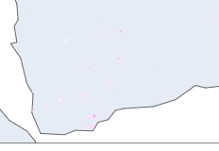
GROUPS INVOLVED IN DIFFERENT THEATRES ACROSS GLOBE FROM 1970-2017.
THEATRE - MIDDLE EAST
EGYPT
TERROR GROUP - Islamic State in Egypt(Ansar Bayt al-Maqdis (Ansar Jerusalem)) MOTIVE - Implementation of sharia in the Sinai Peninsula.
TERROR GROUP - Arms of Egypt Movement (Hasm Movement) MOTIVE - To target egyptian govt personels and to anhillate egyptian government.
TERROR GROUP - Popular Resistance Movement (Egypt) MOTIVE - Religiously nationalist rather than jihadist, as the ideology revolves around nationalist causes like retribution for Morsi’s removal from power, rather than the jihadist mission of a unified caliphate or combating worldwide oppression of Muslims.
TERROR GROUP - Hamas (Islamic Resistance Movement) MOTIVE - Attacked multiple government personnel.
TERROR GROUP - Egyptian Tawhid and Jihad MOTIVE - UNKNOWN
TERROR GROUP - Al-jamāʻah al-islāmīyah MOTIVE - The group was dedicated to the overthrow of the Egyptian government and replacing it with an Islamic state; the group has committed to peaceful means following the coup that toppled Mohamed Morsi.
YEMEN
TERROR GROUP - Houthis
-> TERROR MOTIVE - The Houthis have portrayed themselves as national resistance, defending all Yemenis from outside aggression
and influences, as champions against corruption, chaos, and extremism, and as representative for the interests of marginalized tribal groups
and the Zayidi sect.
TERROR GROUP - Aden-Abyan Islamic Army
-> TERROR MOTIVE - The groups stated goal is to "hoist the banner of al-Jihad, and fight secularism in Yemen and the Arab countries.
TERROR GROUP - Al-Qaeda in the Arabian Peninsula
-> TERROR MOTIVE - objectives include overthrowing the regime in Sana’a; assassinating Western nationals and their allies, including members of the Saudi royal family; striking at related interests in the region, such as embassies and energy concerns; and attacking the U.S. homeland.
Fig 1
fig-2

Slide 17
GROUPS INVOLVED IN DIFFERENT THEATRES ACROSS GLOBE FROM 1970-2017.
THEATRE - MIDDLE EAST
TURKEY
TERROR GROUP - Kurdistan Workers' Party (PKK)
TERROR MOTIVE - Its aims and objectives have evolved over time towards the goals of national autonomy[64] and democratic confederalism.
TERROR GROUP - Kurdistan Freedom Hawks (TAK)
TERROR MOTIVE - The TAK seek an independent state of Kurdistan.The group violently opposes the Turkish government's policies towards its ethnic Kurdish citizens.
TERROR GROUP - Peace Council
TERROR MOTIVE - The group was supposedly formed within the Turkish Armed Forces clandestinely. It was declared to be the governing council of Turkey during the coup attempt.
TERROR GROUP - Great Eastern Islamic Raiders' Front
TERROR MOTIVE - Viewing Turkey's secular governmental system as "illegal," IBDA-C wishes to destroy the secular state and constitutional system and replace it with religious rule and law, first in Turkey, and then throughout the world. The group has gone about asserting these goals by inflicting armed terror primarily on civilian targets. IBDA-C shares ideological ties with Al-Qaeda.
TERROR GROUP - Communist Party of Turkey/Marxist–Leninist(TKP/ML)
TERROR MOTIVE - people's war against the Turkish government.
TERROR GROUP - Revolutionary People's Liberation Party/Front (DHKP-C)
TERROR MOTIVE - fight against american imperialism.
KUWAIT
TERROR GROUP - Najd Province of the Islamic State
TERROR MOTIVE - Religious fundamentalism
BAHRAIN
TERROR GROUP - Saraya Wa'ad Allah (Waad Allah Brigades)
TERROR MOTIVE - The group has stated its pro-Iran stance.The group has also declared to sabotage Israeli interests in Bahrain.
TERROR GROUP - Hezbollah
TERROR MOTIVE - Proxy war against govt and attempted coup .
fig1

Slide 18
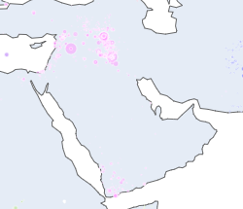
GROUPS INVOLVED IN DIFFERENT THEATRES ACROSS GLOBE FROM 1970-2017.
THEATRE - MIDDLE EAST
CONCLUSION The Middle East is a region that has experienced a significant amount of terrorist activity in recent decades, with several high-profile attacks occurring in countries such as Iraq, Syria, Yemen, and Lebanon. Some of the reasons that have been identified for terrorism in the Middle East include:
Political extremism: Many terrorist attacks in the Middle East are carried out by groups motivated by extremist political ideologies, such as radical Islamism, nationalism, or communism.
Religious extremism: Radical Islamism is a significant driver of terrorism in the Middle East, with groups such as al-Qaeda and ISIS seeking to establish a global caliphate and impose their interpretation of Islamic law.
Foreign interference: The Middle East has long been a site of geopolitical competition, with various outside powers seeking to exert influence in the region. Foreign interference can fuel resentment and anger, and in some cases, lead to violent resistance.
Sectarianism: Many countries in the Middle East are deeply divided along sectarian lines, with tensions between Sunni and Shia Muslims in particular. Sectarianism can create conditions for violence and instability, and terrorist groups may exploit these divisions for their own purposes.
Insurgencies: Some terrorist attacks in the Middle East are carried out by insurgent groups seeking to overthrow or challenge the government, such as the Taliban in Afghanistan or the Houthis in Yemen. It's worth noting that the causes of terrorism in the Middle East are complex and interconnected, and there is no single reason that can fully explain the emergence of terrorism in the region. Additionally, while terrorism can have a devastating impact on individuals and communities, it is still a relatively rare occurrence in most countries in the Middle East
fig1

Slide 19
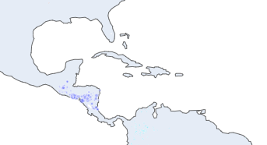
GROUPS INVOLVED IN DIFFERENT THEATRES ACROSS GLOBE FROM 1970-2017.
Central America and Caribbean Theatre
1.From 1970 to 1991 we can see that Central America and Caribbean Theatre was a hotbed of terror attacks which peaked in the mid and late 80s and gradually it decreased in the early 90s the main reason behind this upsurge in terror attacks was not only because of external state and non-state sponsored actors but it also included the internal state and non-state actors.Countries that were affected during the period of 1970-1992->
A- Nicaragua
Terror Group 1 - Sandinista National Liberation Front (FSLN)
Motive- To overthrow the Somoza dictatorship.
Terror Group 2 - Kus Indian Sut Asla Nicaragua ra (Nicaraguan Coast Indian Unity) KISAN , Nicarguan Democratic Front (FDN) , ARDE(Democractic Revolutionary Alliance),CONTRAS, Misurasta indian organisation.
Motive - Counter Re volution to overthrow Sandinista government.
Post this counter revolution 2 Accords were signed to bring peace and harmony in nicaragua
1- Esquipulas II accord defined a number of measures to promote national reconciliation, an end to hostilities, democratization, free elections, the termination of all assistance to irregular forces, negotiations on arms controls, and assistance to refugees. It also laid the ground for international verification procedures and provided a timetable for implementation in order to end the proxies wars .
2 - Sapoá Accords at March 23, 1988 initiated the peace process in Nicaragua.
B- El Salvador
Terror Group 1 - Frente Farabundo Martí para la Liberación Nacional(FMLN) conglomeration of 5 groups "Farabundo Martí" Popular Liberation Forces(FPL), the People's Revolutionary Army (ERP), the National Resistance (RN), the Central American Workers' Revolutionary Party (PRTC) and the Salvadoran Communist Party (PCS).
Motive - To over throw Right Wing govt.
To stop this armed conflict between right wing govt and left wing opposition the peace agreement officially ended the civil war and mandated a major reduction of the country’s armed forces, the dissolution and disarming of guerrilla units, the creation of a new civilian police force (Policía Nacional Civil; PNC), and the establishment of a commission to investigate human rights abuses of the Salvadoran Armed Forces and the FMLN during the war. The FMLN subsequently became a political party. Also in 1992, a century-old territorial dispute between El Salvador and Honduras was settled by the International Court of Justice (ICJ), which awarded Honduras two-thirds of the land in the Gulf of Fonseca and ensured Honduras’s free passage to the Pacific Ocean. El Salvador unsuccessfully appealed this decision before the ICJ in 2002.
fig1

Slide 20
GROUPS INVOLVED IN DIFFERENT THEATRES ACROSS GLOBE FROM 1970-2017.
Central America and Caribbean Theatre
C - Guatemala
Terror Group 1 - Guatemalan National Revolutionary Unity(URNG)
Motive - To fight against the repression that the military and wealthy landowners in Guatemala had created .
Terror Group 2 - Rebel Armed Forces(FAR)
Motive - intended to end corruption in the army and the government and to erase the strain on national honor caused by Ydigoras'.
Terror Group 3 - Guatemalan Labour Party
Motive - To fight against the repression that the military and wealthy landowners in Guatemala had created .
Terror Group 4 - Organization of People in Arms(ORPA).
Motive - To fight against the repression that the military and wealthy landowners in Guatemala had created .
In 1996, after three years of United Nations-moderated peace talks between the Government of Guatemala and representatives from the Unidad Revolucionaria Nacional Guatemalteca (Guatemalan National RevolutionaryUnity, the parties signed the Agreement on a Firm and Lasting Peace, ending decades of civil conflict that began in 1962 and took the lives of over 200,000 Guatemalans.
fig1

Slide 21
GROUPS INVOLVED IN DIFFERENT THEATRES ACROSS GLOBE FROM 1970-2017.
Central America and Caribbean Theatre
CONCLUSION
Terrorism is not a common occurrence in the Caribbean and Central America compared to other regions in the world. However, there have been some incidents of violence that have been labeled as terrorism in these regions. Here are some of the reasons that have been identified as potential causes of terrorism in the Caribbean and Central America:
Drug trafficking: The Caribbean and Central America are major drug transit points, with drug trafficking being a significant source of revenue for criminal organizations. Terrorist groups may use violence to protect their drug trafficking routes and to intimidate law enforcement officials.
Political instability: Some countries in the Caribbean and Central America have a history of political instability and violence, which can provide a fertile ground for the emergence of terrorist groups. Political grievances or a desire for regime change can motivate terrorist acts.
Religious extremism: While religious extremism is not a significant factor in the Caribbean and Central America, there have been some cases where religious extremists have carried out acts of violence. In some cases, these extremists have been motivated by global jihadist ideologies.
Gang violence: Gangs are a significant problem in many countries in the Caribbean and Central America, and they often engage in acts of violence to protect their territories, engage in drug trafficking or carry out extortion.
Foreign influence: Some terrorist groups in the Caribbean and Central America may be influenced by foreign actors, such as other terrorist organizations or state-sponsored actors seeking to advance their geopolitical interests in the region. It's worth noting that the causes of terrorism can be complex and multifaceted, and there is no single reason that can fully explain the emergence of terrorism in any given region.
fig1

Slide 22
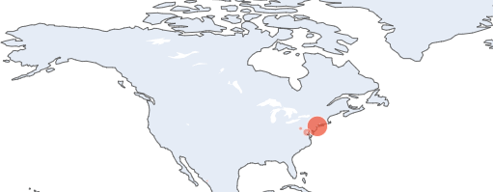
GROUPS INVOLVED IN DIFFERENT THEATRES ACROSS GLOBE FROM 1970-2017.
NORTH AMERICA REGION
United States of America
Terror Group - White Extremists Motive - Protest the ROTC and Vietnam War ROTC, is a program for training students to become commissioned officers of the United States Armed Forces, to prevent school integration,racial conflict in okholoma campus , to stop Interracial marriage by attacking interracial couples to establish white supremacy idea given by Joseph Paul Franklin.
Terror Group - Student radicals Motive - To Protest ROTC program , racial tension in Lawrence kansas , protest against tufet university suspected to be linked with CIA during vietnam war.
Terror Group - Left Wing Militants Motive - Protest against vietnam war and proposal draft , to disrut the trial of H Rap Brown , Protest Natiional Guard.
Terror Group - Ku Klux Klan Motive - To intimidate the people who promote racial harmony, shots fired against black people.
Terror Group - Black Nationalist Motive - To kill police men.
Terror Group - Gaddafi Loyalists Motive - To silence dissidents of gadaffi regime.
Terror Group - Al-Qaida Motive -
Terror Group - Incel Extremists Motive - To promote white supremacy and increase racial tension as well giving a strong white supremacy message by attempting a mass shooting at public places and killed multiple people in it.
CANADA
Terror Group - Anti Semetic Extremists Motive- Attack on canadian-jewish facilites in response to tension in middle east.
Terror Group - Sikh Extremists Motive - To promote khalisitan Agenda.
fig1

Slide 23
GROUPS INVOLVED IN DIFFERENT THEATRES ACROSS GLOBE FROM 1970-2017.
NORTH AMERICA REGION
CONCLUSION
Terror attacks in North America have been carried out for a variety of reasons, with different groups motivated by different factors. Here are some of the reasons that have been identified as potential causes of terrorism in North America:
Ideological extremism: Some terrorist groups in North America are motivated by extremist ideologies, such as white supremacy, anti-government views, or religious fundamentalism.
Revenge or retaliation: In some cases, terrorist attacks in North America have been carried out as a form of retaliation for perceived injustices or as revenge for past actions taken by governments or other groups.
Political activism: Some terrorist attacks in North America have been carried out by groups that are motivated by political activism, such as anti-abortion activists or environmental extremists.
Mental illness: In some cases, individuals who carry out terrorist attacks in North America may suffer from mental illness, which can lead them to act out in violent ways.
Access to firearms: The easy availability of firearms in North America has been identified as a factor that can contribute to the frequency and lethality of terrorist attacks.
It's worth noting that the causes of terrorism can be complex and multifaceted, and there is no single reason that can fully explain the emergence of terrorism in any given region. Additionally, it's important to acknowledge that while terrorism can have a devastating impact on individuals and communities, it is still a relatively rare occurrence in North America.
fig1

Slide 24
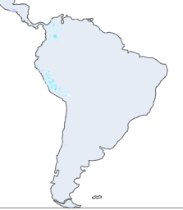
GROUPS INVOLVED IN DIFFERENT THEATRES ACROSS GLOBE FROM 1970-2017.
SOUTH AMERICA
Colombia
Terror Group - Popular Liberation Army (EPL) Motive - The Popular Liberation Army (EPL) was a Marxist guerrilla group that formed in 1967 as the armed wing of the Communist Party of Colombia (Marxist-Leninist), a splinter party of the Colombian Communist Party (PCC). The EPL openly used the drug trade to finance its operations in an attempt to achieve its goal of protecting the proletariat from government influence. In 1991, less than half of the group demobilized and transformed itself into a political party while the majority of members continued militant activities as a dissident group under the leadership of Megateo, originally the leader of one of EPL’s factions, the Libardo Mora Toro Front.
Terror Group - The National Liberation Army (ELN) Motive - Political Idealogical battle between govt of colombia and left rebel groups.
Terror Group - FARC Motive - The FARC and other guerrilla movements claim to be fighting for the rights of the poor in Colombia to protect them from government violence and to provide social justice through communism.
Terror Group - M-19 Motive - The M-19 and other guerrilla movements claim to be fighting for the rights of the poor in Colombia to protect them from government violence and to provide social justice through communism.
Venezuela
Terror Group - Red Flag Party Motive - Throughout history Red Flag has raised various proposals framed in human progress, social justice and popular unity, putting aside opportunism and immediacy that does not allow raising a policy appropriate to the times in which we live and using the socialist revolutionary principles of criticism and self-criticism.
Terror Group - Cartel of the Suns Motive - The Cartel of the Suns (Spanish: Cartel de los Soles) is a Venezuelan organization supposedly headed by high-ranking members of the Armed Forces of Venezuela who are involved in international drug trade.
Peru
Terror Group - Shining Path(Maoist guerilla group) Motive - Political Ideology Conflict.
fig1

Slide 25
GROUPS INVOLVED IN DIFFERENT THEATRES ACROSS GLOBE FROM 1970-2017.
SOUTH AMERICA
CONCLUSION
Terrorism is not a widespread phenomenon in South America, but there have been some incidents of terrorist attacks in the region. Here are some of the reasons that have been identified as potential causes of terrorism in South America:
Political extremism: Some terrorist groups in South America are motivated by extremist political ideologies, such as communism, anarchism, or nationalist movements.
Drug trafficking: South America is a major producer of drugs, particularly cocaine, and drug trafficking is a significant source of revenue for criminal organizations. Terrorist groups may use violence to protect their drug trafficking routes and to intimidate law enforcement officials.
Social and economic inequality: Many countries in South America suffer from high levels of poverty and social inequality, which can create conditions for social unrest and political violence. In some cases, terrorist groups may emerge as a response to perceived injustices.
Ethnic and cultural tensions: South America is home to a diverse range of ethnic and cultural groups, and tensions between these groups can sometimes lead to acts of violence.
Foreign influence: Some terrorist groups in South America may be influenced by foreign actors, such as other terrorist organizations or state-sponsored actors seeking to advance their geopolitical interests in the region. It's worth noting that the causes of terrorism can be complex and multifaceted, and there is no single reason that can fully explain the emergence of terrorism in any given region. Additionally, it's important to acknowledge that while terrorism can have a devastating impact on individuals and communities, it is still a relatively rare occurrence in South America.
fig1

Slide 26

GROUPS INVOLVED IN DIFFERENT THEATRES ACROSS GLOBE FROM 1970-2017.
EASTERN & WESTERN EUROPE
UNITED KINGDOM
INCIDENT- Pan Am Flight 103 (PA103/PAN103) was a regularly scheduled Pan Am transatlantic flight from Frankfurt to Detroit via a stopover in London and another in New York City. The transatlantic leg of the route was operated by Clipper Maid of the Seas, a Boeing 747-121 registered N739PA. Shortly after 19:00 on 21 December 1988, while the aircraft was in flight over the Scottish town of Lockerbie, it was destroyed by a bomb that had been planted on board, killing all 243 passengers and 16 crew in what became known as the Lockerbie bombing.
TERROR GROUP - Unknown as per dataset (but we did extensive research on internet and we found out that there are multiple groups which were claiming responsibility) whose names are listed below :-
TERROR GROUP 1 - Guardians of the Islamic Revolution
MOTIVE - destroyed the plane in retaliation for Iran Air Flight 655 being shot down by US forces in the Persian Gulf the previous July.
TERROR GROUP 2 - Islamic Jihad Organization
MOTIVE - A caller claiming to represent the Islamic Jihad Organization told ABC News in New York that the group had planted the bomb to commemorate Christmas.
TERROR GROUP - Red Hand Commando(RHC) MOTIVE- Intially in dataset it was unkown but we did extensive research on internet and find out the most predictable motive of the group which was to combat Irish republicanism – particularly the Irish Republican Army (IRA) and to maintain Northern Ireland's status as part of the United Kingdom. The Red Hand Commando carried out shootings and bombings, primarily targeting Catholic civilians.
TERROR GROUP - Irish Republican Army MOTIVE - Group belief that all of Ireland should be an independent republic free from British rule.
TERROR GROUP - Ulster Volunteer Force (UVF) MOTIVE - The UVF's declared goals were to combat Irish republicanism – particularly the Irish Republican Army (IRA) – and to maintain Northern Ireland's status as part of the United Kingdom. It was responsible for more than 500 deaths. The vast majority (more than two-thirds) of its victims were Irish Catholic civilians, who were often killed at random.
fig1

Slide 27

GROUPS INVOLVED IN DIFFERENT THEATRES ACROSS GLOBE FROM 1970-2017.
EASTERN & WESTERN EUROPE
IRELAND
TERROR GROUP - Saor Éire (Free Ireland) MOTIVE - Far-left political organisation established in September 1931 by communist-leaning members of the Irish Republican Army, with the backing of the IRA leadership. Notable among its founders was Peadar O'Donnell, former editor of An Phoblacht and a leading far-left figure in the IRA. Saor Éire described itself as "an organisation of workers and working farmers".
TERROR GROUP - Ulster Volunteer Force (UVF) MOTIVE - The UVF's declared goals were to combat Irish republicanism – particularly the Irish Republican Army (IRA) – and to maintain Northern Ireland's status as part of the United Kingdom. It was responsible for more than 500 deaths. The vast majority (more than two-thirds) of its victims were Irish Catholic civilians, who were often killed at random.
TERROR GROUP - Irish Republican Army (IRA) MOTIVE - Group belief that all of Ireland should be an independent republic free from British rule.
TERROR GROUP - Loyalist Volunteer Force (LVF) MOTIVE - Opposition to Irish republicanism and the Northern Ireland peace process.
FRANCE
TERROR GROUP - Breton Liberation Front(BLF) MOTIVE - Aims were to seek greater autonomy for the region of Brittany separate from the rest of France.
TERROR GROUP - National Liberation Front of Corsica(FLNC) MOTIVE - advocates an independent state on the island of Corsica, separate from France.
TERROR GROUP - ETA(Euskadi Ta Askatasuna("Basque Homeland and Liberty"or "Basque Country and Freedom") MOTIVE - The group was founded in 1959 and later evolved from a group promoting traditional Basque culture to a paramilitary group engaged in a violent campaign of bombing, assassinations, and kidnappings throughout Spanish territory and especially in the Southern Basque Country. Its goal was gaining independence for the Basque Country.ETA was the main group within the Basque National Liberation Movement and was the most important Basque participant in the Basque conflict.
TERROR GROUP - Irish Republican Army (IRA) MOTIVE - Group belief that all of Ireland should be an independent republic free from British rule.
TERROR GROUP - Iparretarrak ("Those of the North", "the Northerners", in French) MOTIVE - Is an armed clandestine organization which fights for the independence of the Basque Country,the fight against real estate speculation in the Basque Country to curb the increase in housing prices , by targeting real estate agencies and tourist residences in particular;the preservation of a diversified economic model by preventing a specialization of the territory around mass tourism and the fight against precarious work for young people Temporary work agencies are thus frequently targeted by the group's actions the defense of the Basque language and culture by trying in particular to counter their folklorization through tourism with other actors such as Herri Taldeak.
TERROR GROUP - Informal Anarchist Federation MOTIVE - To protest the economic austerity measures being adopted by Eurozone member states.
fig1

Slide 28
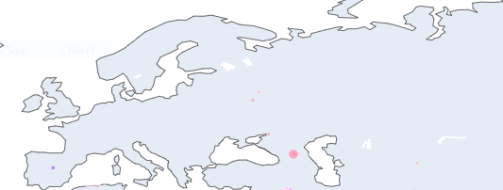
GROUPS INVOLVED IN DIFFERENT THEATRES ACROSS GLOBE FROM 1970-2017.
EASTERN & WESTERN EUROPE
CONCLUSION
Europe has experienced a significant number of terrorist attacks in recent years, with a variety of groups and individuals carrying out these attacks for different reasons. Here are some of the reasons that have been identified as potential causes of terrorism in Europe:
Ideological extremism: Some terrorist attacks in Europe have been carried out by individuals or groups that are motivated by extremist ideologies, such as radical Islamism, far-right nationalism, or far-left politics.
Revenge or retaliation: In some cases, terrorist attacks in Europe have been carried out as a form of retaliation for perceived injustices or as revenge for past actions taken by governments or other groups.
Political activism: Some terrorist attacks in Europe have been carried out by groups that are motivated by political activism, such as animal rights activists or anti-globalization protesters.
Mental illness: In some cases, individuals who carry out terrorist attacks in Europe may suffer from mental illness, which can lead them to act out in violent ways.
Marginalization and discrimination: Marginalized communities in Europe, such as Muslim minorities, may feel discriminated against or excluded from mainstream society, which can lead to feelings of resentment and a desire for retribution.
Foreign influence: Some terrorist groups in Europe may be influenced by foreign actors, such as other terrorist organizations or state-sponsored actors seeking to advance their geopolitical interests in the region.
It's worth noting that the causes of terrorism can be complex and multifaceted, and there is no single reason that can fully explain the emergence of terrorism in any given region. Additionally, it's important to acknowledge that while terrorism can have a devastating impact on individuals and communities, it is still a relatively rare occurrence in Europe.
fig1

Slide 29

GROUPS INVOLVED IN DIFFERENT THEATRES ACROSS GLOBE FROM 1970-2017.
AUSTRALASIA AND OCEANIA
AUSTRALIA
TERROR GROUP - Greek-Bulgarian-Armenian Front MOTIVE - Under the name of "Greek-Bulgarian-Armenian Front", the JCAG perpetrated two attacks in Australia: the bombing of Melbourne's Turkish consulate, for which ARF member Levon Demirian was sentenced and served 10 years in prison, and the bombing of a mail sorting facility in Brisbane, on January 19, 1987.
TERROR GROUP - Informal Anarchist Federation (FAI) MOTIVE - FAI is opposed to capitalism, nationalism, and Marxism.
CONCLUSION
Oceania is generally considered to be a low-risk region for terrorist attacks, with relatively few incidents occurring in recent years. However, there have been a few instances of terrorism in the region, and several potential causes have been identified:
Political extremism: Some terrorist groups in Oceania are motivated by extremist political ideologies, such as far-right nationalism or separatist movements.
Religious extremism: Although religious extremism is not a significant problem in Oceania, there have been some instances of terrorism motivated by radical Islamism.
Social and economic inequality: Like many regions, Oceania suffers from high levels of social and economic inequality, which can create conditions for social unrest and political violence. In some cases, terrorist groups may emerge as a response to perceived injustices.
Foreign influence: Some terrorist groups in Oceania may be influenced by foreign actors, such as other terrorist organizations or state-sponsored actors seeking to advance their geopolitical interests in the region. It's worth noting that the risk of terrorism in Oceania is generally considered to be relatively low, and the region is not typically seen as a major target for terrorist groups. Nonetheless, the threat of terrorism should not be ignored, and governments in the region may take steps to prevent and respond to terrorist attacks.
fig1

Slide 30
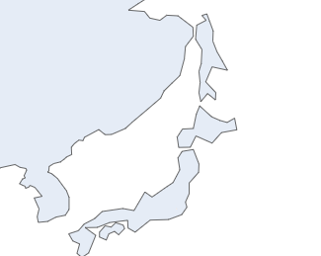
GROUPS INVOLVED IN DIFFERENT THEATRES ACROSS GLOBE FROM 1970-2017.
EAST ASIA
JAPAN
TERROR GROUP - JAPANESE RED ARMY MOTIVE - Political ideological battle with government.
TERROR GROUP - East Asia Anti-Japan Armed Front(EAAJAF) MOTIVE - The EAAJAF self-identifies as a leftist group which espouses Anti-Japaneseism ideology of revolution against the Japanese state, corporations, and symbols of Japanese imperialism, and was classified as a far-left illegal group inspired by anti-Japanese anarchism.The EAAJAF committed a series of bombings as three cells during the early 1970s, including the 1974 Mitsubishi Heavy Industries bombing, until it was disbanded when most of its membership were arrested by Japanese authorities.
TERROR GROUP - Kakurōkyō (Revolutionary Workers'Council) MOTVE - There was long-running conflict between the government of Japan and an alliance of leftist activists who were opposed to the airport for ideological reasons with local farmers who did not wish their land to be appropriated.
TERROR GROUP - Chukakuha MOTIVE - Political ideological battle with government.
TERROR GROUP - Seiji Kesha Kokuyukai MOTIVE - Political ideological battle with government.
SOUTH KOREA
TERROR GROUP - Northwest Youth League MOTIVE - The Northwest Youth League was a right-wing, anti-communist South Korean paramilitary group active during the Cold War. It is most well known for committing widespread atrocities during the South Korean government-led suppression of the Jeju Uprising.
TERROR GROUP - Student radiclas MOTIVE - Agtitation against govt policies and adminstration incompetency.
TERROR GROUP - Uighur Separtists MOTIVE - Movement toward a separate Uyghur state.
fig1

Slide 31
GROUPS INVOLVED IN DIFFERENT THEATRES ACROSS GLOBE FROM 1970-2017.
EAST ASIA
CONCLUSION
East Asia is generally considered to be a region with a relatively low level of terrorism, with few terrorist attacks occurring in recent years. However, there have been some instances of terrorism in the region, and several potential causes have been identified:
Political extremism: Some terrorist attacks in East Asia have been carried out by groups motivated by extremist political ideologies, such as left-wing or right-wing movements.
Religious extremism: While religious extremism is not a major problem in East Asia, there have been some instances of terrorism motivated by radical Islamism or other forms of religious extremism.
Separatist movements: Some terrorist groups in East Asia are motivated by a desire for independence or autonomy for a particular region or ethnic group, such as the Uighurs in China or the Moro people in the Philippines.
Social and economic inequality: Like many regions, East Asia suffers from high levels of social and economic inequality, which can create conditions for social unrest and political violence. In some cases, terrorist groups may emerge as a response to perceived injustices.
Foreign influence: Some terrorist groups in East Asia may be influenced by foreign actors, such as other terrorist organizations or state-sponsored actors seeking to advance their geopolitical interests in the region.
fig1

Slide 32



GROUPS INVOLVED IN DIFFERENT THEATRES ACROSS GLOBE FROM 1970-2017.
SOUTH EAST ASIA
Philippines
TERROR GROUP - New People's Army(NPA)(armed wing of the Communist Party of the Philippines (CPP) MOTIVE - To consolidate political power from what it sees as the present "bourgeois reactionary puppet government" and to aid in the "people's democratic revolution".
TERROR GROUP - Kabataang Makabayan ("Patriotic Youth") MOTIVE - Revolutionaries who would establish a country led by the working class instead of oligarchic politicians.
TERROR GROUP - Abu Sayyaf Group (ASG) MOTIVE - To promote an independent Islamic state in western Mindanao and the Sulu Archipelago.
TERROR GROUP - ALEX BONCAYO BRIGADE MOTIVE - Agitation against increase in oil price.
TERROR GROUP - Moro Islamic Liberation Front (MILF) MOTIVE - Autonomous region of the Moro people from the central government.
THAILAND
TERROR GROUP - Patani United Liberation Organisation(PULO) MOTIVE - A separatist insurgent group in Thailand, calling for an independent Patani.Currently, PULO has a policy of targeting those it views as collaborators and associates of the Thai government, such as teachers, civil servants, soldiers and policemen.The organisation carries out car bombs, road side bombs and drive-by shootings targeting Thai military and police, whom they see as legitimate targets, but also has struck at civilian targets as well.
TERROR GROUP - Seperatists MOTIVE - Rift between muslim minorites and buddhist majorities .
fig1
fig2

Slide 33

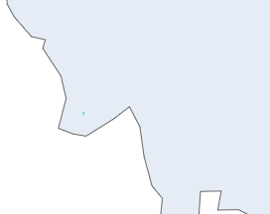
GROUPS INVOLVED IN DIFFERENT THEATRES ACROSS GLOBE FROM 1970-2017.
SOUTH EAST ASIA
MYANMAR
TERROR GROUP - SHAN STATE PROGRESSIVE PARTY MOTIVE - Independence struggle that has led to intermittent civil war within Burma for decades.
TERROR GROUP - Karen National Union (KNU),karen insurgents MOTIVE - The armed group has called for a federal system rather than an independent Karen State.
TERROR GROUP - Kachin Independence Army, MOTIVE - To establish an independent Kachin republic.
TERROR GROUP - Mon insurgent group MOTIVE- To push for constitutional and political reforms through the government sponsored National Convention.
TERROR GROUP - Kareeni National Progressive Party MOTIVE - Assilants asked villagers to join group villager refused so they killed all villagers
TERROR GROUP - All Burma Students' Democratic Front(ABSDF) MOTIVE - The objective of the group is to free the people of Myanmar from the oppression of the military, to create a democracy with political freedom and respect for human rights, to obtain nationwide peace, and to introduce a federal system in the country.
TERROR GROUP - United National Liberation Front (UNLF) MOTIVE - Retaliation because authorites seized arms on 2013.
TERROR GROUP - Ta'ang National Liberation Army(TNLA) MOTIVE - The TNLA is known for their opposition to drug trade, conducting operations where they actively destroy poppy fields, heroin refineries and meth labs. The TNLA claims that they arrest opium smugglers regularly and the narcotics seized are publicly burned on special occasions to deter drug trade.
TERROR GROUP - Rohingya Extremists MOTIVE - Clash between majority buddhist and minority muslims .
TERROR GROUP - Arakan Rohingya Salvation Army (ARSA) MOTIVE - Defend the rights of Rohingyas.
fig1

Slide 34

GROUPS INVOLVED IN DIFFERENT THEATRES ACROSS GLOBE FROM 1970-2017.
SOUTH EAST ASIA
Indonesia
TERROR GROUP - Mujahidin Indonesian Timur (MIT) MOTIVE - MIT has targeted Indonesian Government officials and security forces, and had killed numerous civilians and police officers in multiple attacks.
TERROR GROUP - Jamaah Ansharut Daulah MOTIVE - The group has carried out numerous attacks since its formation, including the May 2018 attacks on three churches in Surabaya, a port city on Java Island’s east coast, killing at least 13 people and injuring 40 others. In May 2017, the group conducted two suicide bombings in East Jakarta, killing three police officers. In June 2017, the group attacked a police headquarters in North Sumatra’s provincial capital of Medan, killing a police officer. In January 2016, the group conducted an attack by a suicide bomber and gunmen in Jakarta’s shopping district, killing two people and injuring 25 others. ISIL has claimed credit for JAD attacks, including the 2018 Surabaya bombings.
TERROR GROUP - Free Aceh Movement (GAM) MOTIVE - Seeking independence for the Aceh region of Sumatra,Indonesia.
fig1

Slide 35
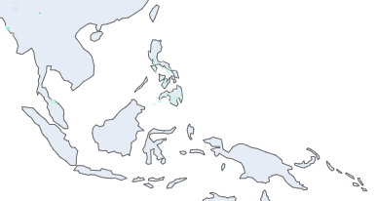
GROUPS INVOLVED IN DIFFERENT THEATRES ACROSS GLOBE FROM 1970-2017.
SOUTH EAST ASIA
Southeast Asia is a region that has experienced a significant amount of terrorist activity in recent decades, with several high-profile attacks occurring in countries such as Indonesia, the Philippines, and Thailand. Some of the reasons that have been identified for terrorism in Southeast Asia include:
Religious extremism: Many terrorist attacks in Southeast Asia are motivated by radical Islamism, with groups such as Jemaah Islamiyah (JI) and Abu Sayyaf being particularly active in the region.
Separatist movements: Some terrorist groups in Southeast Asia are motivated by a desire for independence or autonomy for a particular region or ethnic group, such as the Moro Islamic Liberation Front (MILF) in the Philippines or the Free Aceh Movement in Indonesia.
Social and economic inequality: Many countries in Southeast Asia suffer from high levels of poverty and social inequality, which can create conditions for social unrest and political violence. In some cases, terrorist groups may emerge as a response to perceived injustices.
Foreign influence: Some terrorist groups in Southeast Asia may be influenced by foreign actors, such as other terrorist organizations or state-sponsored actors seeking to advance their geopolitical interests in the region.
Insurgencies: Some terrorist attacks in Southeast Asia are carried out by insurgent groups that seek to overthrow or challenge the government, such as the Communist Party of the Philippines or the United Wa State Army in Myanmar.
It's worth noting that the causes of terrorism in Southeast Asia are complex and interconnected, and there is no single reason that can fully explain the emergence of terrorism in the region. Additionally, while terrorism can have a devastating impact on individuals and communities, it is still a relatively rare occurrence in Southeast Asia.
fig1

Slide 36
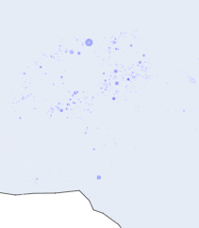
GROUPS INVOLVED IN DIFFERENT THEATRES ACROSS GLOBE FROM 1970-2017.
SOUTH ASIA
PAKISTAN
TERROR GROUP - Abu Nidal Organization (ANO) MOTIVE - The ANO was secular and anti-Western, but was not particularly associated with any ideology, or at least no such foundation was communicated.The organization was strongly linked with Abu Nidal's personal agenda.The group carried out hijackings, assassinations and kidnappings of diplomats, and attacks on synagogues – 90 attacks during the period 1974–1992.
TERROR GROUP - Al-Zulfiqar MOTIVE - Al-Zulfiqar was formed to avenge Bhutto's killing by means of armed struggle against the military regime of General Zia-ul-Haq.
TERROR GROUP - Aghwar "Fire War" Group MOTIVE - Attack on Government (Diplomatic)
TERROR GROUP - The Pakistani government blamed the Afghan intelligence agency for the car bombings. But most of Pakistanis, including Muttahida Qaumi Movement, blamed the ZIa regime for the bombings..
TERROR MOTIVE - political turmoil between ruling govt and other insurgent groups.
TERROR GROUP - Mujahideen and local Sunni tribesmen. MOTIVE - Shia Turis prevented Sunni Mujahideen fighters from passing into Afghanistan.
TERROR GROUP - DACOITS MOTIVE - Looting the masses for food and finance of daily need.
TERROR GROUP - Islamist extremists MOTIVE - Ideological conflict among tribes as well as with the then ruling govt.
TERROR GROUP - Afghans MOTIVE - 1995 Peshawar bombing: At least 25 people were killed and 100 wounded by a car bomb at 6:30pm in Peshawar's Saddar Street market. The bomb was a timing device, using 55 pounds of explosives. Wadood & Sons department store & 8 cars were also set ablaze by the explosion.
TERROR GROUP - Kalpar Tribesmen MOTIVE - Internal tribes rivalry which leads to killing of 3 people and 10 got injured
TERROR GROUP - Shia muslim extremists MOTIVE - Shia and sunni ideological and majority vs minority conflict.
TERROR GROUP - Ujjan tribe MOTIVE - Mostly targeted the business.
TERROR GROUP - Foreign non state or state actor MOTIVE - An explosion occured in a bus in phool nagar in 1996 the motive of bomb blast was not clear.
TERROR GROUP - Lashkar-e-Jhangvi (LeJ) MOTIVE - Mass casualty attacks against the Shia community.
TERROR GROUP - Shinwani Tribe MOTIVE - Internal ideological conflict between shia and sunni
TERROR GROUP - Lashkar-e-Omar MOTIVE - Its reported mission is to attack Americans in Pakistan.
TERROR GROUP - Al-qaida MOTIVE - Motive was to kill president of pakistan general parvez mushraff.
fig1

Slide 37
GROUPS INVOLVED IN DIFFERENT THEATRES ACROSS GLOBE FROM 1970-2017.
SOUTH ASIA
PAKISTAN
TERROR GROUP - Sipah MOTIVE - In retaliation to sialkot killing
TERROR GROUP - Balochistan Liberation Army MOTIVE - To kill military personel
TERROR GROUP - Harkatul Jihad-e-Islami MOTIVE - To assassinate benizir bhutoo and kill as many as supporter of her as possible at an opportune PR moment
TERROR GROUP- Tehrik -i-Taliban Pakistan (TTP) MOTIVE - Fight against the NATO-led International Security Assistance Force.
TERROR GROUP - JUNDALLAH(PAKISTAN) MOTIVE - Sectarian conflict between shia and sunni.
TERROR GROUP - KHORASAN CHAPTER OF ISLAMIC STATE MOTIVE - To take revenge of jundhallah killing.
AFGHANISTAN
TERROR GROUP - TALIBAN MOTIVE - The Taliban have said they aim to restore peace and security to Afghanistan, including Western troops leaving, and to enforce Sharia, or Islamic law, once in power.
TERROR GROUP - Khorasan Chapter of the Islamic State MOTIVE - The group aims to establish control of Central Asia and South Asia under the Khorasan Province banner of the self-declared caliphate.
TERROR GROUP - HAQQANI NETWORK MOTIVE - Elements within the Pakistani security establishment continue to view the Haqqani network as a useful ally and proxy force to represent their interests in Afghanistan. To this end, Haqqani forces have repeatedly targeted Indian infrastructure and construction projects in Afghanistan.
TERROR GROUP - Lashkar-e-Taiba (LeT) MOTIVE -The group has adopted maximalist agenda of global jihad though its operations.
TERROR GROUP - Tehrik-i-Taliban Pakistan (TTP) MOTIVE - TTP’s stated objectives are the expulsion of Islamabad’s influence in the Federally Administered Tribal Areas and neighboring Khyber Pakhtunkhwa Province in Pakistan.
TERROR GROUP - Jaish-e-Mohammed MOTIVE - To expel foreign troops from Afghanistan.
TERROR GROUP - KHORASAN CHAPTER OF ISLAMIC STATE MOTIVE - Aims for the establishment of an Islamic caliphate in Afghanistan.
TERROR GROUP - Hezb-i-Islami Afghanistan (HIA) MOTIVE - War against the Soviets and Kabul administrations.
fig1
fig2

Slide 38
GROUPS INVOLVED IN DIFFERENT THEATRES ACROSS GLOBE FROM 1970-2017.
SOUTH ASIA
BANGLADESH
TERROR GROUP - Jama'atul Mujahideen Bangladesh (JMB) MOTIVE - The Jama'atul Mujahideen Bangladesh (Party of the Mujahideen) aims at establishing the rule of Islam in Bangladesh through an armed struggle. The outfit is opposed to the establishment of democracy and calls for the conduct of government under Islamic law.
TERROR GROUP - Islamic State – Bengal Province (IS-BP) MOTIVE - The push for a united Islamic state across the subcontinent has been a catalyst for homegrown action and international interest in Bangladesh. Bombings, shootings and stabbings have been claimed by ISIL, targeting Westerners and other foreigners and Shia Muslims.
TERROR GROUP - Ansarullah Bangla Team (ABT) MOTIVE -Implicated in crimes including some brutal attacks and murders of atheist bloggers from 2013 to 2015 and a bank heist in April 2015.
TERROR GROUP - Hizb ut-Tahrir MOTIVE -
Terror Group - Bangladesh Jamaat-e-Islami MOTIVE - Strongly opposed the independence of Bangladesh and break-up of Pakistan.
TERROR GROUP - Purbo Banglar Communist Party MOTIVE - The PBCP follows a Maoist and staunchly Nationalist ideology it aims to overthrow the Bangladeshi government and replace it with a Communist state inspired by Maoist era China.The PBCP is staunchly anti-India, it views India as a hegemon in the region.
TERROR GROUP - Harkat-ul-Jihad-al-Islami MOTIVE - Aims to spread Radical Islamist ideology to liberate the rest of Islamic lands from the clutches of the enemies of Islam.
fig1

Slide 39

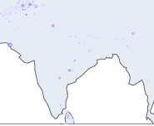
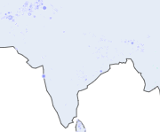
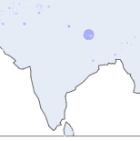
GROUPS INVOLVED IN DIFFERENT THEATRES ACROSS GLOBE FROM 1970-2017.
SOUTH ASIA
INDIA
TERROR GROUP - Lashkar-e-Taiba(LeT) MOTIVE - The organization's stated objective is to merge the whole of Kashmir with Pakistan.
TERROR GROUP - Jaish-e-Mohammed ("The Army of Muhammad", abbreviated as JeM) MOTIVE - The group's primary motive is to separate Kashmir from India and merge it into Pakistan.
TERROR GROUP - Tehreek-ul-Mujahideen (TuM) MOTIVE - The TuM aims to merge the Indian State of Jammu and Kashmir (J&K) with Pakistan and also promote a pan-Islamist identity.
TERROR GROUP - Hizbul Mujahideen MOTIVE - Its goal is to separate Kashmir from India and merge it with Pakistan. It is one of the most important players that evolved the narrative of the Kashmir conflict from nationalism to radical jihad.
TERROR GROUP - People's Liberation Army of Manipur, often shortened to just People's Liberation Army (PLA-MP or PLAM) MOTIVE - A separatist group fighting for a separate independent socialist state of Manipur, a state in northeastern India.
TERROR GROUP - United Liberation Front of Asom (ULFA) MOTIVE - It seeks to establish an independent sovereign nation state of Assam for the indigenous Assamese people through an armed struggle in the Assam conflict.
TERROR GROUP - Garo National Liberation Army (GNLA) MOTIVE - The GNLA is fighting for a 'sovereign Garoland' in the Western areas of Meghalaya.
TERROR GROUP - National Socialist Council of Nagaland (NSCN) MOTIVE - The main aim of the organisation is to establish a sovereign Naga state, "Nagalim", which would consist of all the areas belonging to the Naga people in Northeast India and northwest Myanmar.The NSCN's slogan is "Nagaland for Christ".
TERROR GROUP - People's Liberation Front of India (PLFI) MOTIVE - struggle within the confines of the Constitution, get rid of exploitative regimes, corrupt politicians and bureaucrats.
TERROR GROUP - People's Revolutionary Party of Kangleipak (PREPAK) MOTIVE - armed insurgent group in Manipur demanding a separate and independent homeland.
TERROR GROUP - Khalistan Liberation Force (KLF) MOTIVE - Its motive is the creation of a sovereign Sikh state called Khalistan via armed struggle.
TERROR GROUP - Al Umar Mujahideen (AuM) MOTIVE - The AuM aims to liberate the Indian State of Jammu and Kashmir through an armed struggle and merge it with Pakistan.
TERROR GROUP - Jammu Kashmir Liberation Front (JKLF) MOTIVE - The organization committed itself to a political struggle in order to achieve its objective of independence for the entire region of the former princely state of Jammu and Kashmir from both India and Pakistan.
TERROR GROUP - Karbi People's Liberation Tiger (KPLT) MOTIVE - KPLT is formed with an objective of carving an Autonomous Karbi State (AKS) out of Assam. The KPLT pledged to fight until the AKS is formed. Significantly, Jing Hanse, on the outfit's Foundation had declared that his party would continue subversive activities if their demands were not met.
Fig1 ,Fig2,Fig3

Slide 40
GROUPS INVOLVED IN DIFFERENT THEATRES ACROSS GLOBE FROM 1970-2017.
SOUTH ASIA
INDIA
TERROR GROUP - Tehreek-e-Hurriyat MOTIVE - Jammu and Kashmir is a disputed territory and India's control of it is not justified. It supports the Pakistani claim that Kashmir is the "unfinished agenda of Partition" and needs to be solved "as per the aspirations of the people of Jammu and Kashmir.
TERROR GROUP - Dashmesh Regiment MOTIVE - To create a Sikh homeland called Khalistan via armed struggle.
TERROR GROUP - The Zeliangrong United Front MOTIVE - Its objective is to create a ‘Zeliangrong’ state within the Indian territory, covering the Zeliangrong Naga tribe’s area in the three northeastern states.
TERROR GROUP - United Jihad Council MOTIVE - The organisation was created to unify and focus efforts of various armed militant groups fighting against Indian rule in Kashmir.
TERROR GROUP - National Democratic Front of Boroland (NDFB) MOTIVE - To obtain a sovereign Boroland for the Bodo people.
TERROR GROUP - Kanglei Yawol Kanna Lup MOTIVE - Seperate mainpur from india.
TERROR GROUP - Hmar People's Convention- Democracy (HPC-D) MOTIVE - The purported objective of the outfit over the years has changed from an autonomous district covering the north and northeast Mizoram to an independent Hmar State (Hmar ram) consisting of the Hmar inhabited areas of Mizoram, Manipur and Assam.
TERROR GROUP - National Liberation Front of Tripura MOTIVE - The NLFT seeks to secede from India and establish an independent Tripuri state and is an active participant in the Insurgency in Northeast India.
TERROR GROUP - Indian Mujahideen MOTIVE - To spread fundamentalism.
TERROR GROUP - Communist Party of India (Maoist) MOTIVE - The CPI (Maoist) observes that the Indian state is being "run by a collaboration of imperialists, the comprador bourgeoisie and feudal lords." Believe in the 'annihilation of class enemies' and in extreme violence as a means to secure organizational goals.
TERROR GROUP - Babbar Khalsa International (BKI) MOTIVE - Creation of an independent state of Khalistan for Sikhs in the Punjab region of South Asia (including some districts of neighbouring Indian states).
TERROR GROUP - Khalistan Zindabad Force (KZF) MOTIVE - To create a separate country Sikh homeland called Khalistan by carving Punjab and some parts of neighbouring states of Haryana, Rajasthan and Himachal Pradesh out of Indian union.
TERROR GROUP - Khalistan Commando Force (KCF) MOTIVE - Its objective is the creation of a Sikh independent state of Khalistan through armed struggle.
.
Fig1 ,Fig2,Fig3

Slide 41




GROUPS INVOLVED IN DIFFERENT THEATRES ACROSS GLOBE FROM 1970-2017.
SOUTH ASIA
SRILANKA
TERROR GROUP - Bodu Bala Sena(BBS) MOTIVE - The BBS generally opposes pluralist and democratic ideologies, and criticizes non-extremist Buddhist monks for not taking action against the rise of Western religions within Sri Lanka.
TERROR GROUP - Liberation Tigers of Tamil Eelam (LTTE) MOTIVE - The LTTE was a self-styled national liberation organisation with the primary goal of establishing an independent Tamil state.
Tamil nationalism was the primary basis of its ideology.
TERROR GROUP - Janatha Vimukthi Peramuna(JVP) MOTIVE -The motive was to establish a socialist state.
.
Fig 1.

Slide 42
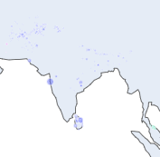
GROUPS INVOLVED IN DIFFERENT THEATRES ACROSS GLOBE FROM 1970-2017.
SOUTH ASIA
South Asia is a region that has experienced a significant number of terrorist attacks in recent years. The causes of terrorism in South Asia are complex and multifaceted, but some of the reasons that have been identified include:
Religious extremism: Many terrorist attacks in South Asia are motivated by radical Islamism, with groups like Al-Qaeda and the Taliban being particularly active in the region.
Political extremism: Some terrorist attacks in South Asia are carried out by groups that are motivated by extremist political ideologies, such as Maoist or Marxist movements in India and Nepal.
Ethnic and sectarian tensions: South Asia is home to a diverse range of ethnic and religious groups, and tensions between these groups can sometimes lead to acts of violence.
Social and economic inequality: Many countries in South Asia suffer from high levels of poverty and social inequality, which can create conditions for social unrest and political violence. In some cases, terrorist groups may emerge as a response to perceived injustices.
Foreign influence: Some terrorist groups in South Asia may be influenced by foreign actors, such as other terrorist organizations or state-sponsored actors seeking to advance their geopolitical interests in the region.
Insurgencies: Some terrorist attacks in South Asia are carried out by insurgent groups that seek to overthrow or challenge the government. It's worth noting that the causes of terrorism in South Asia are complex and interconnected, and there is no single reason that can fully explain the emergence of terrorism in the region. Additionally, while terrorism can have a devastating impact on individuals and communities, it is still a relatively rare occurrence in South Asia.
.
Fig 1.

Slide 43


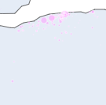
GROUPS INVOLVED IN DIFFERENT THEATRES ACROSS GLOBE FROM 1970-2017.
AFRICA
ALGERIA
TERROR GROUP - Islamic State – Algeria Province (IS-AP)
TERROR MOTIVE -Attack citizens of countries fighting with the U.S.against IS.
TERROR GROUP - Al-Qaeda in the Lands of the Islamic Maghreb
TERROR MOTIVE - aims to overthrow the Algerian government and institute an Islamic
state.
TERROR GROUP - Al-Mua'qi'oon Biddam Brigade (Those who Sign with Blood)
TERROR MOTIVE - To topple algerian govt and establish islamic state.
TERROR GROUP - Movement for Oneness and Jihad in West Africa(MUJAO).
TERROR MOTIVE - The intended goal of spreading jihad across a larger section of West
Africa, as well as demanding the expulsion of all French interests (especially military
and resources) that operates in West Africa, which they regard as "colonialist
occupiers".
TERROR GROUP - Salafist Group for Preaching and Combat(GSPC)
TERROR MOTIVE - To topple algerian govt and establish islamic state.
TERROR GROUP - Armed Islamic Group (GIA)
TERROR MOTIVE - fought the Algerian government and army not to pressure the
government into concessions but to destabilise and overthrow it.
TERROR GROUP - Algerian Moslem Fundamentalists
TERROR MOTIVE -The attacks on foreigners and on Europe that they want to force world opinion over to the side of a change in Algerian politics.
TERROR GROUP - Islamic Salvation Front(FIS)
TERROR MOTIVE - supported fundamentalism and targeted many civilians.
.
Fig 1.

Slide 44
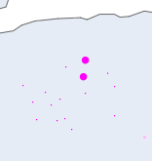
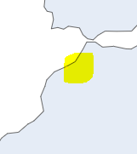
GROUPS INVOLVED IN DIFFERENT THEATRES ACROSS GLOBE FROM 1970-2017.
AFRICA
LIBYA
TERROR GROUP - Tripoli Province of the Islamic State
TERROR MOTIVE - To carry forward mission of global umah or global calphite .
TERROR GROUP - Benghazi Defense Brigades (BDB)
TERROR MOTIVE - take control of five cities and two major oil producing areas in the east of
the country.
TERROR GROUP - Libya Revolutionaries Operations Room
TERROR MOTIVE - LROR attempted an Islamist coup when the group kidnapped Prime
Minister Ali Zeidan in October 2013.
TERROR GROUP - Misrata Brigades
TERROR MOTIVE - To fight against dicatorship regime in Libya
TERROR GROUP - Ansar al-Sharia (Libya)
TERROR MOTIVE - Their goal is to establish sharia and to remove US and Western influence
from Libya.
Morocco
TERROR GROUP - Salafia Jihadia
MOTIVE - Spread fundamentalism in country
TERROR GROUP - Al-Qaida in the Islamic Maghreb (AQIM)
MOTIVE - To overthrow morocoo govt and establish fundamentalism in society.
.
Fig 1.
Fig 2.

Slide 45

GROUPS INVOLVED IN DIFFERENT THEATRES ACROSS GLOBE FROM 1970-2017.
AFRICA
TUNISIA
TERROR GROUP - Jund al-Khilafah
MOTIVE - participating in the financing, planning, facilitating, preparing, or perpetrating of acts or
activities by, in conjunction with, under the name of, on behalf of, or in support of ISIL (Da’esh) and
Al Qaida.
TERROR GROUP - Tunisian Armed Resistance
MOTIVE - Civil resistance against longtime president Zine El Abidine Ben Ali.
TERROR GROUP - Al-Qaida
-> MOTIVE - The Tunisian Interior ministry accused the group of masterminding the 2013 wave of political assassinations in Tunisia.
TERROR GROUP - Okba Ibn Nafaa Brigade
MOTIVE - Promoting and forcing masses to follow a particular sect of fundamentalism.
TERROR GROUP - Islamic State of Iraq and the Levant (ISIL)
MOTIVE - Promoting and forcing masses to follow a particular sect of fundamentalism by
overthrowing current regime.
Fig 1.

Slide 46
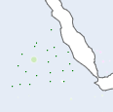
GROUPS INVOLVED IN DIFFERENT THEATRES ACROSS GLOBE FROM 1970-2017.
AFRICA
SUDAN
TERROR GROUP - National Salvation Front (NAS)
MOTIVE - removal of the President of South Sudan, Salva Kiir, from office and the establishment of federalism.
TERROR GROUP - Ansaru (Jama'atu Ansarul Muslimina Fi Biladis Sudan)
MOTIVE - the group has vowed to restore the "dignity of Muslims in black Africa" by reviving the Sokoto Caliphate.
TERROR GROUP - Fulani extremists
MOTIVE - As the frontier of the Sahara Desert has moved southward, Fulani herds have gradually been pushed southward
toward Nigeria’s “Middle Belt,” a handful of states straddling the pre-colonial line dividing Nigeria’s predominantly Muslim
north from its Christian south. The Middle Belt is a farming region, and the advancing Fulani-owned herds have
increasingly encroached on croplands.The resulting conflicts over land have taken on an ethnic and religious character, as
many of the farmers of Nigeria’s Middle Belt are ethnic Berom, an indigenous people who are predominantly Christian.
TERROR GROUP - Janjaweed
MOTIVE - clash over water and grazing land, shortages of which are being exacerbated by the climate crisis.
TERROR GROUP - Misseriya Arab Tribesmen
MOTIVE - Disputed South Sudan border region.
TERROR GROUP - South Sudan United Front (SSUF)
MOTIVE - to “arrest the carnage” in the country, saying President Salva Kiir could not be trusted to lead the nation to
peace.
TERROR GROUP - Sudan People's Liberation Movement in Opposition (SPLM-IO)
MOTIVE - To protect tribal interests or felt marginalized by the government due to their previous membership in the SSDF.
Fig 1.

Slide 47
GROUPS INVOLVED IN DIFFERENT THEATRES ACROSS GLOBE FROM 1970-2017.
AFRICA
SUDAN
TERROR GROUP - Zaghawa extremists
MOTIVE - extremisim to increase there sphere of influence.
TERROR GROUP - Sudan Liberation Movement/Army(SLM/A)
MOTIVE - The structural inequity in the Sudan that denies non-Arabs equal justice and power
sharing.
TERROR GROUP - Lord's Resistance Army (LRA)
MOTIVE - establishment of multi-party democracy,ruling Uganda according to the Ten
Commandments and Acholi nationalism.
TERROR GROUP - Sudan People's Liberation Movement – North
MOTIVE - to change the policies of the centre in Khartoum and to build a new centre for the
benefit of all Sudanese people regardless of their religion, gender or ethnicity background.
TERROR GROUP - David Yau Yau Militia
MOTIVE - insurrection against the South Sudanese government in Jonglei state.
TERROR GROUP - South Sudan Liberation Movement (SSLM)
MOTIVE - To assert the rights of the people of South Sudan to freedom and self-determination.
Fig 1.

Slide 48

GROUPS INVOLVED IN DIFFERENT THEATRES ACROSS GLOBE FROM 1970-2017.
AFRICA
Democratic Republic of the Congo
TERROR GROUP - Nyatura Militia
MOTIVE - Battle for control of the DRC.
TERROR GROUP - Mai Mai Simba Militia
MOTIVE -To defend local communities and territory against other armed groups.
TERROR GROUP - Democratic Forces for the Liberation of Rwanda(DFLR)
MOTIVE - Group opposed to the ethnic Tutsi influence.
TERROR GROUP - Allied Democratic Forces(ADF)
MOTIVE - To promote one particular religion extremism and increase sphere of influence.
TERROR GROUP - Patriotic Resistance Front in Ituri (FRPI)
MOTIVE -Counterweight to the Rwanda-backed and Hema-dominated Union of Congolese Patriots (UPC) in the Ituri conflict.
TERROR GROUP - Kamwina Nsapu Militia
MOTIVE - militia against state security forces .
TERROR GROUP - Bundu dia Kongo(BDK)
MOTIVE - supports the creation of an ethnically-Kongo state with borders similar to the pre-colonial Kingdom of Kongo during the 15th century.
TERROR GROUP - Lord's Resistance Army (LRA)
MOTIVE - its stated goals include establishment of multi-party democracy, ruling Uganda according to the Ten Commandments and Acholi nationalism.
TERROR GROUP - Nationalist and Integrationist Front(FNI)
MOTIVE - The ambush and murder of nine United Nations peacekeepers near the town of Kafe in February 2005.
TERROR GROUP - Hutu extremists
MOTIVE - Ideology that asserts the ethnic superiority of Hutu, often in the context of being superior to Tutsi and Twa, and that therefore they are entitled to dominate and murder these two groups and other minorities.
TERROR GROUP - Banyamulenge
MOTIVE - To establish there sphere of influence .
Fig 1.

Slide 49

GROUPS INVOLVED IN DIFFERENT THEATRES ACROSS GLOBE FROM 1970-2017.
AFRICA
Central African Republic
TERROR GROUP - Anti-balaka
MOTIVE - attacking civilians and communities known or perceived to be connected to
the Séléka.
TERROR GROUP - Union for Peace in the Central African Republic(UPC)
MOTIVE - Attacked NGO,Private property,citzens.
TERROR GROUP - Popular Front for the Renaissance of the Central African Republic (FPRC)
MOTIVE - The FPRC operates a parallel state in the northern part of the Central African
Republic.They have their own police, gendarmes, prisons, and military bases.They also
collect taxes and fees. They profit from gold and diamond mines in areas they control
including Ndassima mine, which they share control with the UPC.
TERROR GROUP - Séléka
MOTIVE - Anti govt militia
Fig 1.

Slide 50
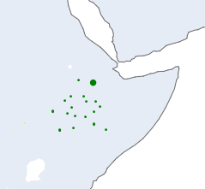
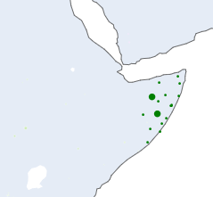

GROUPS INVOLVED IN DIFFERENT THEATRES ACROSS GLOBE FROM 1970-2017.
AFRICA
ETHIOPIA
TERROR GROUP - Murle Tribe
MOTIVE- Cross border Massacare.
GROUP - Ogaden National Liberation Front(ONLF)
MOTIVE - attacked on resources to generate funds.
GROUP - Oromo Liberation Front
MOTIVE - Political conflict
TERROR GROUP - Eritrean Liberation Front
MOTIVE - Fight for Eritrea's independence from Ethiopia.
GROUP -Tigray People's Liberation Front (TPLF)
MOTIVE - Against the Derg regime
SOMALIA
TERROR GROUP - Al-Shabaab
MOTIVE- To promote a particular religion in pan africa .
TERROR GROUP - Ogaden National Liberation Front(ONLF)
MOTIVE - Attacked on resources to generate funds
CHAD
TERROR GROUP - BOKO HARAM
MOTIVE - to create a “pure” Islamic state ruled by sharia law.
TERROR GROUP - Union of Forces for Democracy and Development (UFDD)
MOTIVE - opposed to former President Idriss Déby.
TERROR GROUP - Movement for Democracy and Justice
MOTIVE - To oust the government of the current Chadian president Idriss Déby.
TERROR GROUP - Coup plotters
MOTIVE - To oust the govt of ruiling president.
Fig 1.
Fig 2.
Fig 3.

Slide 51
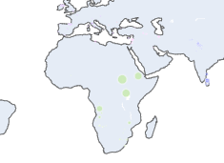
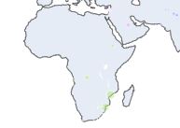
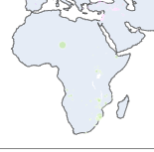
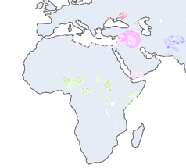
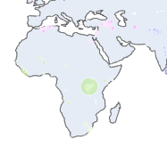
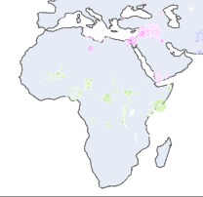
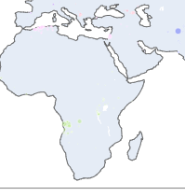
GROUPS INVOLVED IN DIFFERENT THEATRES ACROSS GLOBE FROM 1970-2017.
AFRICA
Terrorism is a significant problem in many parts of Africa, with several countries experiencing high levels of violence and instability due to terrorist attacks. Some of the reasons that have been identified for terrorism in Africa include:
Political instability: Many countries in Africa are politically unstable, with weak governments, corrupt officials, and ineffective law enforcement. This creates conditions in which terrorist groups can operate with relative impunity.
Poverty and social inequality: Many parts of Africa suffer from high levels of poverty, unemployment, and social inequality, which can fuel resentment and anger among marginalized communities. Terrorist groups may exploit these grievances to recruit new members and carry out attacks.
Ethnic and religious tensions: Many countries in Africa are deeply divided along ethnic and religious lines, with longstanding tensions and conflicts between different groups. These divisions can create conditions for violence and instability, and terrorist groups may exploit these tensions to carry out attacks.
Foreign intervention: Some terrorist groups in Africa have been influenced or supported by outside powers seeking to advance their geopolitical interests in the region. For example, groups such as Boko Haram in Nigeria have been linked to outside extremist groups and may have received funding and support from abroad.
Insurgencies: Some terrorist attacks in Africa are carried out by insurgent groups seeking to overthrow or challenge the government, such as Al-Shabaab in Somalia or the National Liberation Front in Algeria. It's worth noting that the causes of terrorism in Africa are complex and interconnected, and there is no single reason that can fully explain the emergence of terrorism in the region. Additionally, while terrorism can have a devastating impact on individuals and communities, it is still a relatively rare occurrence in most countries in Africa
Fig1

Slide 52
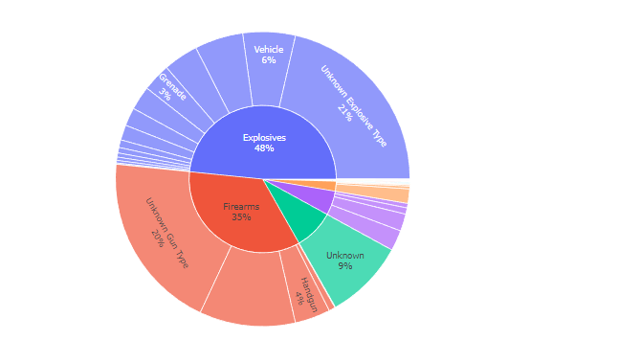
WEAPONS USED FREQUENTLY.
Explosives have the ability to cause widespread destruction and loss of life, which makes them an attractive option for terrorists who want to make a powerful statement or achieve a specific political goal. They can be easily acquired from a variety of sources, including military stockpiles, black markets, and even common household items. Also the psychological impact of a terrorist attack involving explosives is often greater than that of other types of attacks. The sight and sound of an explosion can create chaos and panic, leading to a greater sense of fear and uncertainty among the public.
Radiological, chemical and biological are the least used weapon type because these types of weapons are highly complex and require specialized knowledge to manufacture and deploy. RCB weapons require access to highly restricted materials, such as radioactive isotopes or deadly pathogens. Obtaining these materials can be very challenging, and terrorists may not have the resources or connections to acquire them. Moreover, they are not as reliable as conventional weapons, and their effects can be unpredictable. Terrorist groups may be concerned about unintended consequences, including harm to themselves or their own supporters

Slide 53
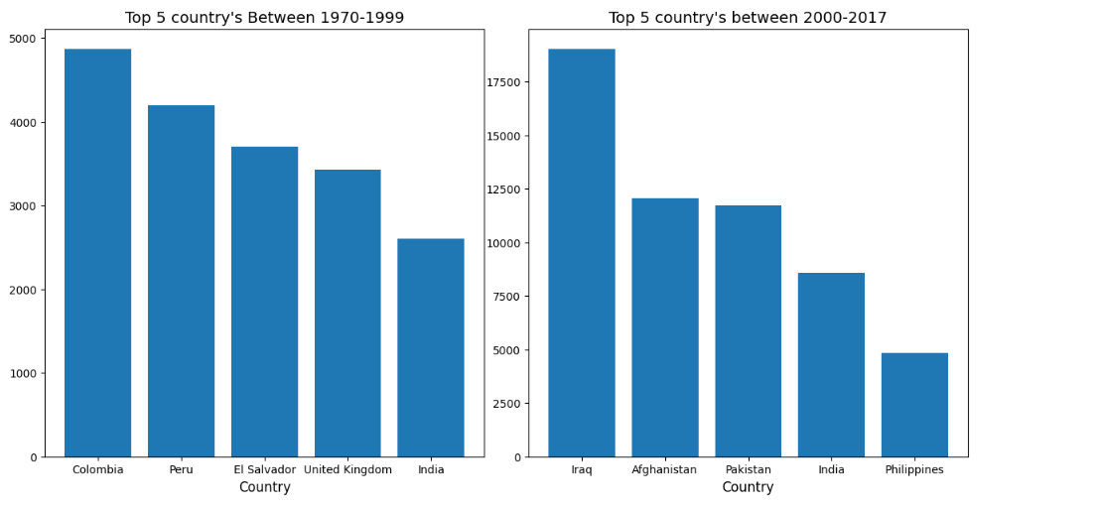
OBSERVATION
From 1970-1999 we can see that south america region witnessed the most number of attacks out of which Colombia, Peru and El Salvador witnessed the majority of attacks the reason behind such attacks were mainly releated to organised crime sector where trading of drugs,prostiution,organ trafficking,money launderig,arms trafficking etc the ultimate aim of syndicates and cartel is to generate profits from it and concentrate whole wealth in the hands of few and once the economic consolidation is achieved the sphere of influence further expands in other state organisation in order to smoothly run there ilegal machinery .
We can observe that India jumped from rank 5 to rank 4 in 21st century there are multiple reasons behind it some the major reasons are A - Foreign state sponsored terrorism to sabotage india culture and unity. B - Internal Security threats like organised crime, Secession of a state from main motherland . C - To hault India economic growth as India have a potential to become superpower.

Slide 54
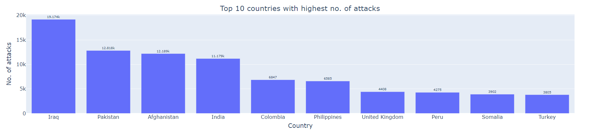
Top 10 countries with highest no. of attacks
OBSERVATIONS
Iraq,Pakistan and Afghanistan witnessed the most number of attacks out of top 10 countries the reason behnid this have multiple dimensions for eg geo political war to capture the resources and setup the monopoly over such resources to maximise the profits and generate the huge amount of wealth apart from economical gain. It also acts as a soil to assert the sphere of influence over the other region and in order to achieve this goal the indoctrination of the massess took place via various communication means like social media, AV, print media etc once the indoctrination achieved and implemented deep inside the masses subconscious mind the actual game of fault line exploitation starts which ultimate leads to sabotage of country culture by constant attacks by terror group, insurgent groups, extremsits. These groups can be either state sponsored or non state sponsored and once the sphere of influence get consolidated the main actor who controls the whole narrative can easily achieve its end goal.

Slide 55

BUSINESS OBJECTIVES
SECURITY SECTOR
The ultimate goal of the project is to provide insights that can be used by governments,law enforcement agencies,and other stakeholders to develop effective counter-terrorism strategies and strengthen the internal security of a country.
HEALTH SECTOR
Terror attacks can have a profound psychological impact on individuals, communities, and even entire nations. Here are some of the common psychological effects of terror attacks on humans:
Fear and anxiety: Terror attacks can cause fear and anxiety among people who fear for their own safety and the safety of their loved ones. People may start to avoid public spaces or crowded events, and may become more vigilant or hyper-aware of their surroundings.
Post-Traumatic Stress Disorder (PTSD): People who experience or witness a terror attack may develop PTSD, which is a psychological condition that can cause a range of symptoms such as flashbacks, nightmares, anxiety, and avoidance of places or activities associated with the traumatic event.
Depression: After a terror attack, people may experience feelings of sadness, hopelessness, and despair. This can lead to depression, which can make it difficult to carry out everyday activities and may require treatment.
Survivor guilt: Those who survive a terror attack may experience feelings of guilt, believing that they were somehow responsible for the attack or that they should have done more to help others.
Anger and frustration: Terror attacks can evoke feelings of anger and frustration among people who are trying to make sense of the attack and cope with their emotions. This can lead to a desire for revenge or a need for justice.
Increased prejudice and discrimination: In some cases, terror attacks can lead to increased prejudice and discrimination against certain groups, such as Muslims or immigrants, who may be unfairly blamed for the attack. Overall, the psychological effects of terror attacks can be long-lasting and may require professional treatment and support. It's important for individuals and communities to take steps to promote healing and resilience in the aftermath of a terror attack.

